Slide 1
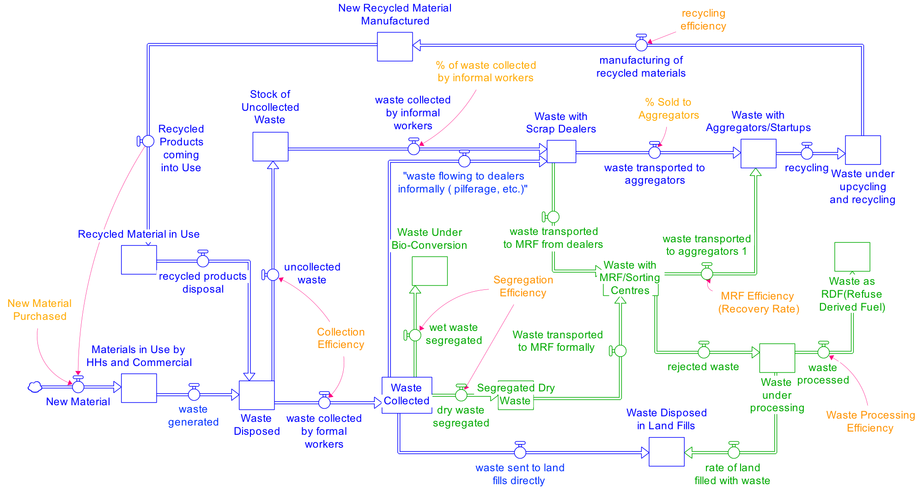
Slide 1 | India-Wide Ecosystem Lens: What Exists, What’s Missing, Gaps & Bottlenecks
Lens date: April 2, 2026 | Uses CPCB FY 2021-22 mass-balance plus GFC 2024-25 and PIB January/March 2026 operating signals
1,62,000 TPD
Urban MSW currently produced in Indian cities
60,478 vs 39,648
Wards with >90% collection vs >90% source segregation
54%
National processing rate in CPCB FY 2021-22 mass-balance
~25 crore MT
Legacy waste identified; >62% processed by January 31, 2026
What is already there
ULB-led collection backbone with concessionaires, fleets and ward systems
A large informal recovery economy of waste pickers, kabadiwalas and scrap traders
Growing MRF, compost, CBG, recycling and EPR infrastructure
SBM-U 2.0, GFC ratings and dumpsite remediation momentum
What is not fully there yet
Consistent source segregation across households and bulk generators
End-to-end traceability for low-value waste streams
Reliable offtake for sorted material across geographies
Formal inclusion of informal workers at system scale
Structural gaps
Feedstock quality, contamination control and route discipline
Working capital and project finance for aggregation and processing
Data interoperability across ULBs, EPR managers and recyclers
Scientific landfill only for true rejects, not routine overflow
Binding bottlenecks on the current map
Segregation gap at source
Post-collection leakage between collection and processing
MRF quality / recovery bottlenecks
Offtake bottlenecks between aggregators and recyclers
Residual dependence on landfill / RDF / processing rejects
Legacy dumpsites still absorbing land, money and management attention
This ecosystem view is additive, not exclusionary: public systems, entrepreneurs, for-profits, nonprofits, cooperatives, consultants, family-backed vehicles and informal actors all matter.

Slide 2
Slide 2 | Actors, Partners & Illustrative India-Wide Examples by System Block
Illustrative, not exhaustive. Each block can host public, private, nonprofit, cooperative, advisory and informal actors.
Consumers & Bulk Waste Generators
Households, RWAs, campuses, hotels, malls, hospitals, stations, airports, factories. Examples: residential societies, Indian Railways sites, airports, IT parks, schools, hospitality chains.
Formal Waste Collectors
ULBs, sanitation departments, ward contractors, concessionaires, fleets, worker teams. Examples: municipal corporations, Antony Waste, city-level collection operators.
Informal Waste Collectors
Waste pickers, itinerant buyers, kabadiwalas, cooperatives, worker groups. Examples: SWaCH, Hasiru Dala, Chintan / Safai Sena, collector networks linked to Plastics for Change.
MRFs / Sorting Centres
Municipal MRFs, DWCCs, zero-waste operators, sorting lines, social enterprises. Examples: Saahas Zero Waste, Hasiru Dala Innovations, Chintan micro-MRFs, city MRF networks.
Scrap Dealers
Kabadi shops, balers, dry-waste godowns, mandi traders and small aggregators. Examples: local kabadi networks, neighborhood dry-waste traders, TheKabadiwala interfaces.
Aggregators
Digital marketplaces, traceability platforms, EPR managers, material consolidators. Examples: Recykal, GEM Enviro, Plastics for Change, Lucro collection network, Cirqlo.
Recyclers
Plastic, metal, paper, e-waste, battery and multi-material recyclers. Examples: Banyan Nation, Lucro, Attero, Gravita, GEM Enviro, Deluxe.
Waste Transporters
Municipal fleets, concessionaire fleets, micro-haulers, bale logistics and reverse logistics partners. Examples: ULB fleets, Antony fleets, producer take-back logistics, local transporters.
Waste Processors
Composters, biomethanation, CBG, RDF, WtE, co-processing and scientific landfill operators. Examples: GPS Renewables, IGRPL, municipal composters, large processing operators.
Same system map, now read as an India-wide actor landscape.
Cross-cutting partners that show up across blocks
MoHUA / SBM-U 2.0, SPCBs / PCCs, ULBs and state urban departments
UNDP India, civil society groups, consultants, research institutions and accelerators
Producer / brand EPR systems, marketplaces, family-backed and strategic capital, and entrepreneur-led platforms

Slide 3
Slide 3 | Capital Layer Attached to the Map: Funders, Philanthropy, CSR, Investors & Enablers
Read capital as sitting on different blocks of the same system. This lens is intentionally inclusive: public, philanthropic, CSR, strategic, venture and family-backed capital all play a role.
Consumers / source segregation
ULB budgets, SBM-U IEC, CSR behavior-change campaigns and donor pilots. Examples: HUL-MoHUA, Tata Trusts, UNDP India.
Informal collectors
Livelihood grants, worker inclusion philanthropy, fair-trade plastic models and CSR skilling. Examples: Body Shop x Plastics for Change, worker-support platforms.
Formal collection / transport
Municipal opex, concessionaire finance, fleet leasing and producer take-back budgets for first-mile and reverse logistics.
MRFs / sorting centres
SBM-U capex, city PPPs, CSR pilots and blended finance for quality upgrades, digitization and traceability. Examples: Social Alpha, Startup Gateway pilots.
Scrap dealers / aggregators
Working capital, EPR manager spend, inventory finance and angel / family-backed capital for consolidation and route discipline.
Recyclers
VC, growth equity, strategic investors, family offices and brand offtake. Examples: Circulate Capital, Claypond Capital, strategic corporate buyers.
Processors
Project finance, infrastructure funds, strategic energy investors and carbon-linked capital for compost, CBG, RDF and scientific processing.
Landfill / legacy waste
Public remediation funds, state support, climate / blended finance and technical assistance. Priority use: dumpsites and scientific rejects management.
Capital does not sit in one box. It shows up differently across first mile, inclusion, aggregation, recycling, processing and legacy remediation.
Illustrative capital actors across the system include Tata Trusts, H&M Foundation, BMGF, USAID, UNDP India, ITC WOW, Coca-Cola India Foundation Anandana, Circulate Capital, Social Alpha, family offices and strategic investors.

